Slide 1
Migration approach and plan
Design, prepare, customize
Test and verify
Analyze, enhance, fine tune
Merge into production

Slide 2
Decide if you want to maintain two environments or merge them into one.
No hard deadline for a merge since it’s optional for all organizations.
No extra tools are required.
Think of it as any data migration process with a complete cycle of testing.
No license impact.

Slide 3

Integration components - Overview
Inventory Visibility
MES Integration
Sensor Data Intelligence
Pricing service*
Finance and operations apps
Data entities
Business Events
Data Events
Data Management
Framework
OData
Synapse Link
Custom classes External endpoints
Custom services
Near real-time
Asynchronous
Outbound
*Preview
Synchronous
Microsoft Entra ID
RESTful services
JSON message format
Inbound
Notes:
During part one we gave an overview of the different endpoints and tools offered by Power Platform, our business applications and Azure.
[CLICK] Today we focus on the endpoints and methods that are relevant for Dataverse specifically, and the Azure components that can be used to build Dataverse integrations.

Slide 4
Synchronous endpoints
OData and custom services
OData
Custom services
Characteristics
Characteristics
RESTful web services
Based on data entities where IsPublic is set to Yes, as many are by default.
Available operations CRUD-A (POST, GET, PATCH, DELETE) and custom actions (POST)
Underlying integration technology for modern clients, such as mobile, web, Excel, Power BI.
Only supports the HTTPS protocol.
SOAP (strongly types WSDL contract) and RESTful JSON available.
Not based on data entities.
Expose X++ methods as service operations, data contract classes for composite types.
Deployed through service groups, endpoints.
Only support the HTTPS protocol.
Metadata service
Common remarks
Characteristics
Latency & Performance
Synchronous endpoints are designed for low latency and low/medium volume.
OData and custom service have shared service protection limits.
Read- only, RESTful.
Labels: https://[baseURI]/Metadata/Labels(Id=‘@SYS333000’,Language=‘en-us’)
Data entities: https://[baseURI]/Metadata/DataEntities
Security
Standard security stack applies. No direct access to the database.
Notes:
When calling external services from your plugins please consider the next:
IP addresses cannot be used. You must use a named web address that requires DNS name resolution.
There is no provision for prompting the logged-on user for credentials.
You must allow connections from Power Platform and Dynamics 365 services IP address values specified under the AzureCloud service tag.
(And as mentioned before only the HTTP and HTTPS protocols are allowed.)
Click - > You can develop plugins in your favourite editor as a compiled class within an assembly built to target .NET Framework 4.6.2. You can access external web services via plugin code either using System.Net.WebClient Class or the latest System.Net.Http.HttpClient class.
Citizen developers can author low-code plugins using the common PowerFx library. With low-code plugins you can run logic on events and also run plugins on demand. We introduced the ability to call connectors from a low- code plugin, and in this launch you can invoke stored procs using SQL connector. In the future we want to support even more connectors. Low-code plugins are currently in preview and not yet ready for production usage, but they are already very powerful, have great potential, so we encourage you to test and provide your feedback.
Click - > Service protection limits are not applied to plug-ins and custom workflow activities. However, if your application performs operations that trigger custom logic, the additional computation time that these operations contribute will be added to the initial request that triggered them. This computation time is part of the service protection API limits. E.g. If you batch import records that trigger plugins, the computation time due to plugins execution is considered towards the service protection limit execution time.
Click - >For Latency, When using plugins for data integration scenarios, its recommended to use post-operation stage with asynchronous mode.
If you opt for synchronous plugins, consider the tight coupling, potential performance issues and 2 minute execution limit. Our general recommendation is to design your plug-in so that it executes in no more than 2 seconds. If your plug-in requires more time to execute, consider registering your plug-in for asynchronous rather than synchronous execution.
Click - > Security
IF you need to store sensitive data, use the plugin secure configuration data which is stored in a separate table that only system administrators have privileges to read, or in a custom table where similarly you would have configure that only administrators have access. Its good to also mention Dataverse environment variables of type secret which are references to Azure Key Vault, and the associated custom API RetrieveEnvironmentVariableSecretValue which used to work with plugins, is designed to work today only with Power Automate. Ofc, for retrieving AKV secrets in PA flow you can use the Azure Key Vault connector.
Click - > Recommendations
A well written plugin is powerful, but a poorly written one can cause significant impact on the performcne of the data processing pipeline. The great power of plug-ins needs to be applied with some restraint and consideration for the impact it has on the system as a whole. And there are alternatives Power Automate, webhooks or integration with Azure services which we will explore next.
===================================================================================
Consider alternatives such as Webhook (low-code) to external APIs, plug-in to Azure Service Bus then poll or trigger like Azure Event Grid for web service
Plugin calls Business Event Custom API with Power Automate flow subscriber. Within flow, you can use call web service (http trigger) or use custom connector.
(– the HttpClient has significant capabilities over WebClient Class which are not necessarly advantageous in plugins. Use the one you prefer in plugins.)

Slide 5
Tech Talk Dynamics 365 and Dataverse - Integration Overview
Presenters:
Corina Balan, Sr. Solution Architect
Michele Mazzucco, Sr. Solution Architect
Co-Presenter/Q&A:
Ali Adamu, Sr. Solution Architect
Notes:
Hello everybody and welcome to today's Dynamics 365 TechTalk.
Today's topic is D365 and Dataverse - Integration Overview
My name is Ali Adamu and I will be your moderator today.
Confidentiality statement
We are broadcasting this session through Teams Live Event.
This session is being recorded on behalf of the Microsoft Corporation.
When you join this event, your name and e-mail address may be viewable by session organizers. By joining you're agreeing to this experience. If you do not consent to be a part of a recorded session, please disconnect your line.​
The recording will be made available in the TechTalks Community Dynamics page within 5 business days.
Encourage Q&A
If you have questions for presenters or need support, please use the Q&A panel located on the right side of your screen. If you wish your name not to be visible to organizers or session participants, please post your questions anonymously. Our presenters will be responding to your questions throughout the session and in a live segment at the end of the presentation. ​​​​​​​
Thank you for your patience during these announcements.
Presenters Introduction
Presenting for us today from Microsoft we have
Corina Balan, Sr. Solution Architect in the FastTrack team
Michele Mazzucco, Sr. Solution Architect in the FastTrack team
Michele over to you to get us started

Slide 6








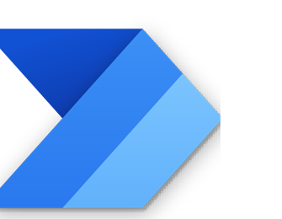

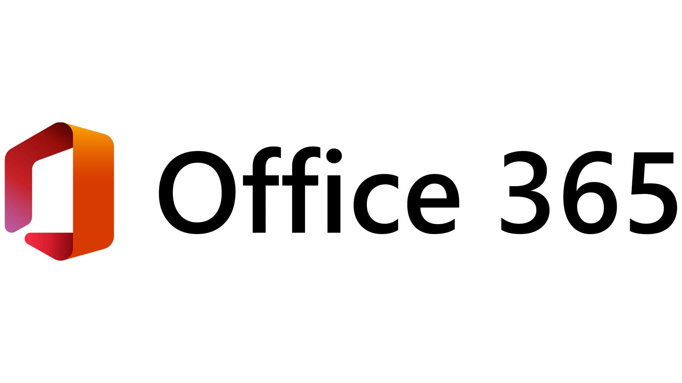
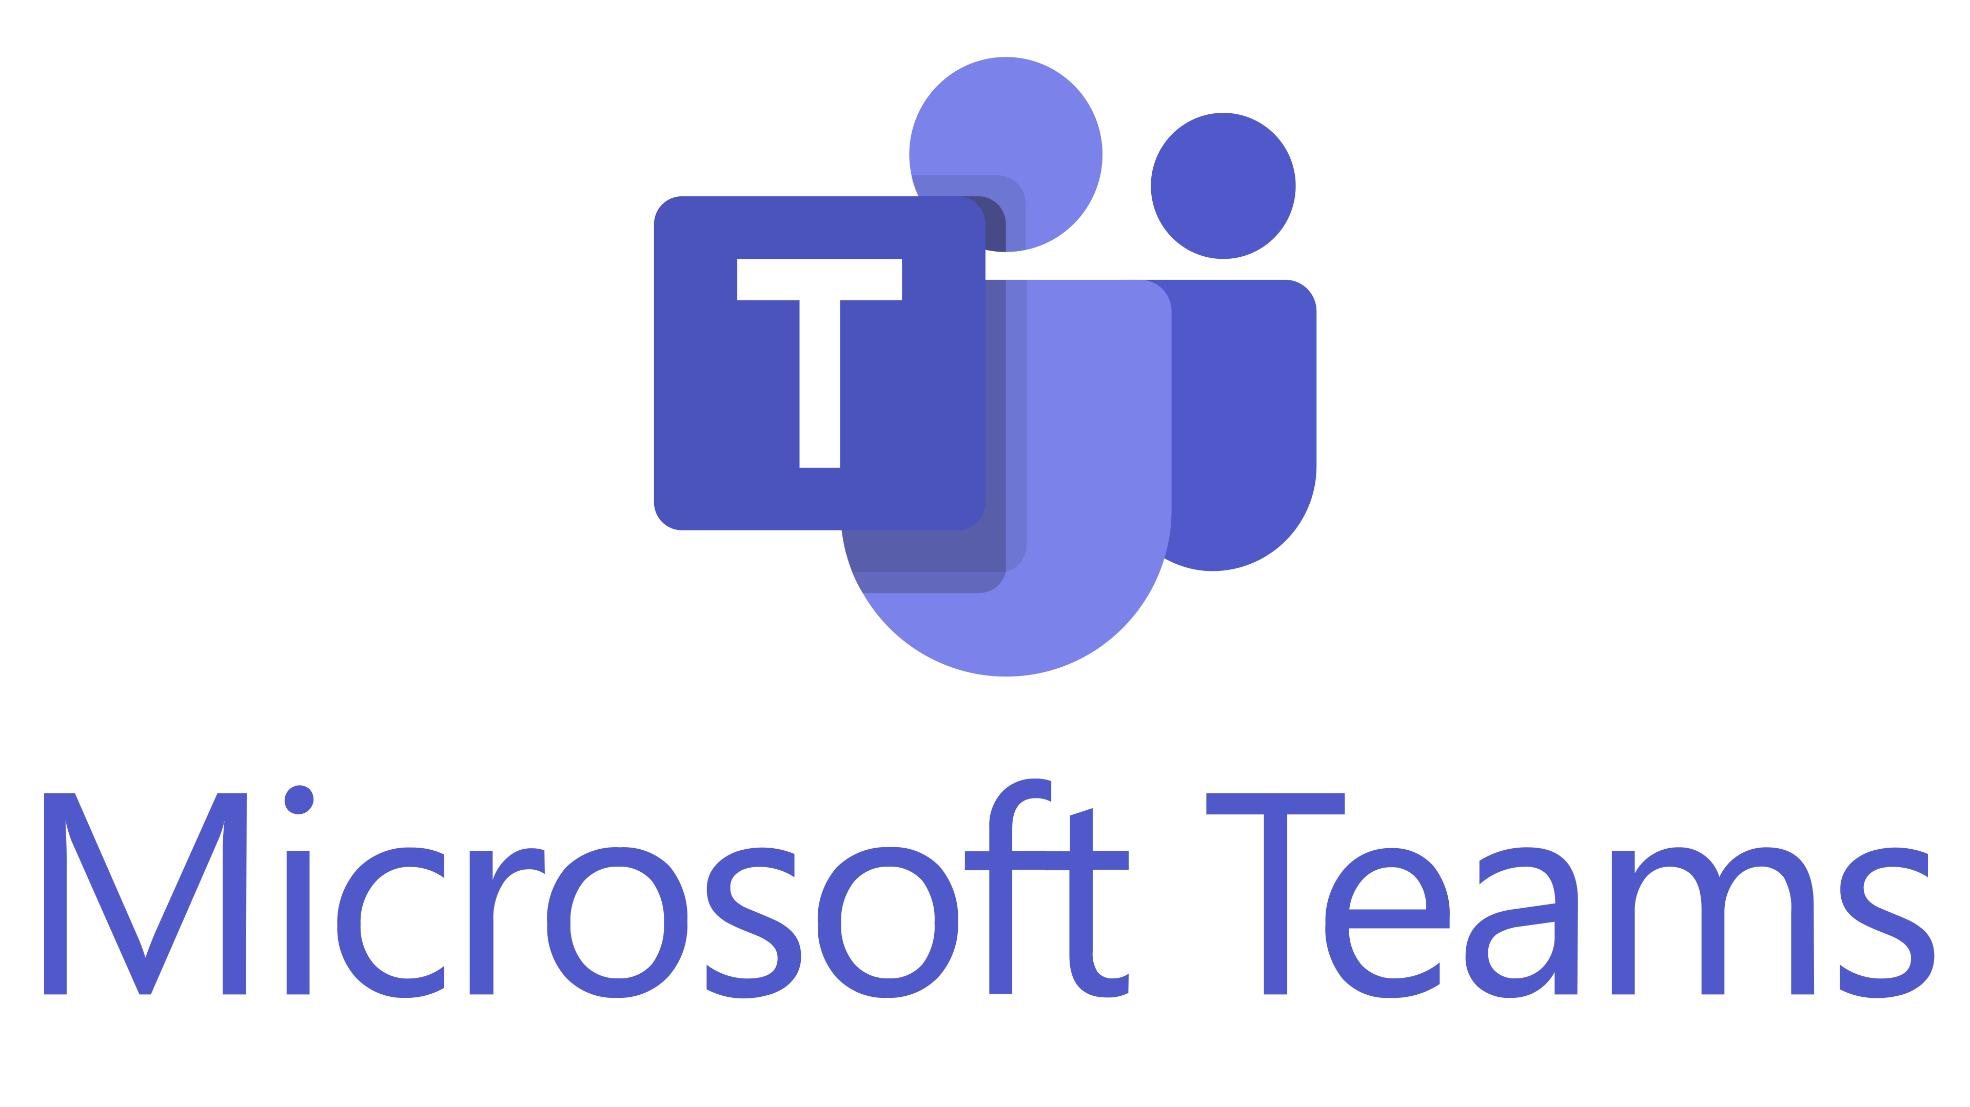
Integration components - Overview
Event Grid
Service Bus
Web Jobs
Data flow
Azure Function
Data Factory
Logic Apps
API management
Power Automate
Inventory Visibility
MES Integration
Demand planning*
Sensor Data Intelligence
Pricing service*
Connected Field Service
Finance and operations apps
Dataverse
Dual Write
OData/Web API
TDS Endpoint
PunchOut e-Procurement
Data entities
Business Events
Data Events
Virtual Table
Data Management
Framework
OData
Plug-in (Synch)
WebHook
Electronic Reporting
Invoice
capture
Synapse Link
Plug-in (Asynch)
Custom classes External endpoints
Custom services
Outbound
Near real-time
Asynchronous
Synchronous
Microsoft Entra ID
JSON message format
Inbound
*Preview
RESTful services
Notes:
During part one we gave an overview of the different endpoints and tools offered by Power Platform, our business applications and Azure.
[CLICK] Today we focus on the endpoints and methods that are relevant for Dataverse specifically, and the Azure components that can be used to build Dataverse integrations.

Slide 7
Dataverse inbound integrations
Different approaches
Dataverse APIs
Dataverse connectors
UI integration
Organization service – defines the operations supported by the platform as messages, provides an SDK for .NET development.
Web API – can be used across a wide variety of programming languages, platforms, and devices. All the same operations as the SDK for .NET but presented in RESTful style.
Power Automate – SaaS, low-code/no-code, using prebuilt or custom connectors.
Logic Apps – PaaS, low-code/no-code or pro development, using prebuilt or custom connectors.
Data factory – managed cloud service for complex ETL and data integration projects.
Virtual tables – integrate data from external systems, represented as Dataverse tables.
Custom controls/pages – add full pages, dialogs, or panes in a model-driven app with the flexibility of canvas designer.
Reports - embed Power BI reports in model-driven apps.
Notes:
When we think about bringing data into Dataverse, there are different approaches we can evaluate.
[CLICK] One approach is to write code to interact directly with the Dataverse API.
When doing this, we have 2 options:
the Organization Service, which defines all the operations supported by the platform as messages, and is accessible from .NET code through the provided SDK
the WebAPI, which exposes the same operations as a RESTful service, and can be consumed via HTTP methods, leveraging OData to define functions and actions
[CLICK] Another possibility is to implement your integrations by using components in Power Platform and Azure that rely on connectors to interact with Dataverse.
This allows for a low-code/no-code approach, and again you have multiple options, for example:
Power Automate, which is a SaaS component, has a wide set of prebuilt connectors, and can be included as a component in solutions
Logic Apps, which offers similar flows capabilities in a PaaS mode, allows pro development through code editing, and is deployed as an Azure resource
Data Factory, which is meant for complex ETL and data integrations, especially with large amount of data
[CLICK] integrating external data in your Power Apps, or Dynamics 365 business applications, doesn’t mean necessarily that data must be physically imported in Dataverse.
You can evaluate to embed real-time data from external sources in your UI, for example:
Leverage Virtual Tables, that allow you to expose external data in any model driven app
Implement custom controls or custom pages, that would offer a specialized UI to query external data
And of course, the reporting option, especially with Power BI that can be embedded into your application forms to aggregate data from external sources

Slide 8
Dataverse outbound integration
Endpoints and common tools
Event driven via Dataverse event framework
Event driven & scheduled with Dataverse connectors
Batch
Plug-ins – integrate with external web services and Azure Services.
Webhooks – HTTP pattern, posts execution context to web service.
Business events – use for internal or external events to notify publishers.
Power Automate – SaaS automation for low-code/no-code integration with 3rd party apps using 1000+ prebuilt connectors or custom connectors for cloud and on-premises connectivity.
Logic Apps – iPaaS automation for advanced integration to automate complex business processes. Tight integration with Azure. Benefit from the same connectors ecosystem as Power Automate.
Azure Synapse Link for Dataverse – continuously export Dataverse data for reporting and analytics use cases.
Change tracking - a set of delta changes is returned by Dataverse for a table.
Notes:
A Dataverse outbound data integration takes data from Dataverse and makes it available to other systems.
For scenarios where an event in Dataverse needs to triggers an integration with an external system, you can consider the next endpoints and common tools :
plugins calling external web services, or posting runtime context to Azure services such as Service Bus, Event Hub,
webhooks posting the runtime context to external web services,
and the most recent feature, Dataverse Business events for asynchronous process integration.
Then For automation, scheduling and also event based integration, tools such as Power Automate, Logic Apps can be triggered by create, update, delete operations via Dataverse connector. With Power Automate and Logic Apps you can easily integrate with the connectors ecosystem with more than 1000 prebuilt connectors and have the option to create custom connectors to break down data barriers.
Click -> For continuous export of data and metadata from Dataverse, we will discuss Azure Synapse Link for Dataverse Service. The main use case for Azure Synapse Link for Dataverse is to run analytics, business intelligence and machine learning scenarios on your data. We have seen customers successfully using the exported data from Azure Data Lake Storage for mainly batch data integrations scenarios when the Synapse Link SLAs or latency were sufficient.
Azure Synapse Link service uses the change tracking feature of Dataverse. Change tracking provides a way for you to keep the data synchronized in an efficient manner by detecting what data has changed since the data last synchronized. When you are retrieving data with change tracking, a set of delta changes is returned by Dataverse.
====================================================================================

